Slide 1
The PreProcessor
CS 580U - Fall 2018

Slide 2
What is the PreProcessor?
Suppose you have a local constant (local to the file) that you don’t want to make global, but you are using it throughout the file, so you don’t want to pass it as a parameter. Solution?
Suck it up, and pass it as a parameter?
Make it global and name it very carefully?
Use a Macro
Macros rely on the built in PreProcessing language in C
Make direct changes to your source before compilation
Uses a separate syntax from C

Slide 3

Text Substitution
Essentially, the Preprocessor is just a text substitution tool
Find/Replace
All macros use preprocessing to find and replace
Find ‘cat’, replace with ‘dog
2 types of macro
Expressions
Code Blocks

Slide 4
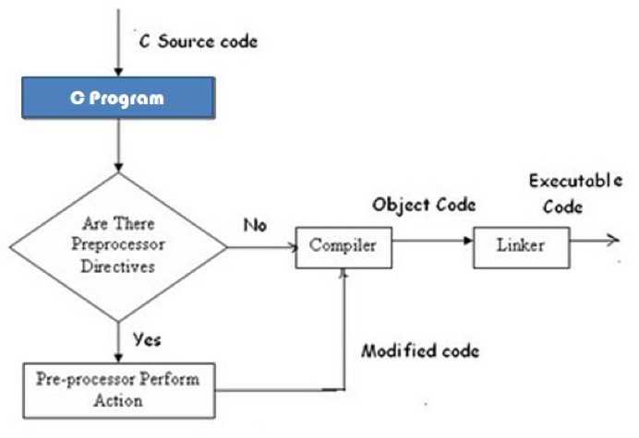
Preprocessor in Compilation

Slide 5
Preprocessing statement
The preprocessing statement always starts with # followed by a keyword without a space.
#include
You can add a preprocessing statement anywhere in your code, but it must go on its own line.

Slide 6
#include
You already use this
Directive:
Find this file
Replace this directive with all the text in the file
Two syntaxes
#include <library.h> //go to the systems library for the source
#include “MyFile.h” //look in the current folder for the file -- more on this later

Slide 7
#define
Allows you to define names for constants
Syntax
#define TRUE 1 //notice no equal sign
Usage
if(TRUE == 1) …
after preprocessing, but before compilation this becomes if(1 == 1) …
Still just text replacement

Slide 8
#define Style Guide
Must be defined before referenced
int var = MY_DEFINE; //wrong! #define MY_DEFINE 1
The preprocessor is still sequential
Defines after #includes
Use all CAPS and underscore for spaces
ANY constant or repeated literal local value should use a #define
Example: #define PI 3.14159265359

Slide 9
Macros
You can also #define expressions
#define THIRD 1/3 int slice = 6 * THIRD
#define RIGHT_SHIFT_BYTE >> 8 int val = 256 RIGHT_SHIFT_BYTE
#define EQUALS == if(x EQUALS y) …
helps with debugging
Notes:
1

Slide 10
Longer Macros
Macros must be contained on one line
Text replacement cannot cross line breaks
To continue to another line, use “\”
#define GREETING \ printf("Hello!\n")
You can send arguments to macros just like a function
Syntax:
#define HALF(x) x/2
Usage:
int pie_portion = HALF(6);

Slide 11
Macro Gotchas
Still just text replacement
No logic to the preprocessor, just find and replace
Order of operations (again)
#define SQUARE(x) x*x; int val = SQUARE(1+1)
What happens when we do this?
result 1+1*1+1 = 3

Slide 12
Solution, as always, Parenthesis
Always isolate your parameters and expression with parenthesis
#define SQUARE(x) (x)*(x)
SQUARE(1+1) becomes
(1+1) * (1+1) = 4

Slide 13
Classwork: PreProcessing

Slide 14
Problems with Macro scope
Given the following macro:
doubleinc(a,b) \ (a)++; \ (b)++;
What happens if we use the macro thusly:
if(x > y) doubleinc(x, y);
Expands to:
if(x > y) (x)++; (y)++;

Slide 15
Isolating your Macros
Always wrap your macros in curly braces
Eliminates accidental control flow problems
Allows intermediate variables without naming conflicts
Scoped Macro
doubleinc(a,b) { \ (a)++; \ (b)++; \ }

Slide 16
Making More Robust Macros
You can use # in a macro to stringify arguments
This allows you to create some nice debugging macros
#define peval(cmd, f) printf(#cmd ": " f "\n", cmd);
peval(var, “%d”)
Preprocessor Strings
The preprocessor automatically concatenates adjacent strings
That is why we can write: #cmd ": " f "\n"
Each part is a string, and gets turned into one string

Slide 17
Predefined Macros
Predefined macros
__DATE__
__TIME__
__FILE__
__LINE__

Slide 18
#ifdef
#ifdef checks if a term has been defined
If true, the code is included in compilation
If false, code is not included in compilation
Does not check the value of the definition
Value can be defined as 0 and still be defined, i.e. not boolean
#define FOO 0 #ifdef FOO int x = 3; #endif
This only gets included in compilation if FOO is defined

Slide 19
#endif
All conditional preprocessor statements must end in #endif
Like the closing brace on a code block
#ifdef FOO …. …. #endif

Slide 20
#ifndef
Preprocessor can also check the inverse
If a name is not defined, execute code
Example
#define FOO 0 #ifndef FOO int x = 3; //won’t get executed #endif

Slide 21
#if, #elif, #else
Additional Macro Statements
#if -- Checks the value, i.e. is boolean
Example
#define FOO 0 #if FOO int x = 3; //won’t get executed #endif
#else -- Preprocessor equivalent of ‘else’
#elif -- Preprocessor equivalent of ‘else if’

Slide 22
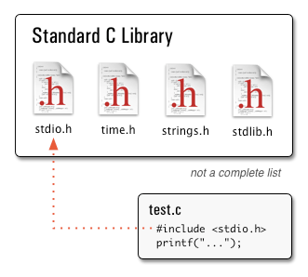
Header Files
Global Declarations (functions, type declarations, etc) should always go in a header file
Header files use the .h extension, <filename>.h
include header files with the #include preprocessor directive
Library and User Created header files
Use header files to ‘modularize’ your code
Do not put executable code in a header file

Slide 23
File Inclusion
MyData.h int x=5; int y=5;
MyProg.c
#include <stdlib.h>
#include “MyData.h”
int main(){ int z = x + y; }

Slide 24
File Inclusion Result
#include <stdlib.h>
int x=5; int y=5;
int main(){
int z = x + y;
}

Slide 25
What if?
xdata.h
#include “ydata.h”
int x = 5;
ydata.h
#include “xdata.h”
int y=5;
MyProg.c
#include <stdlib.h>
#include “xdata.h”
int main(){
int z = x + y;
}

Slide 26
Infinite Loop Include
#include <stdlib.h>
int x = 5;
int y = 5; int x = 5; int y = 5;
…
…

Slide 27
Include Guards
Use include guards in all header files
#ifndef FILENAME_H #define FILENAME_H … //code … #endif
Never, ever, include a source file (file.c)
Only include what is absolutely necessary in header files

Slide 28
Classwork
#define MAN(x, y, z) z = x > y ? 1 : y
Conditional Compilation

